Slide 1
Ustacky Capstone Project for Data Science Micro Degree
Executive Summary

Slide 2
Data Collection
After importing the required python libraries, the required data was collected from the recommended websites and other sources as follows:
A. From John Hopkins GitHub repository: urlj1 = "https://raw.githubusercontent.com/CSSEGISandData/COVID-19/master/csse_covid_19_data/csse_covid_19_time_series/time_series_covid19_recovered_global.csv"
dfj1 = pd.read_csv(urlj1)
B From NCDC website. However, I have problems scraping data from the website as the COVID19 data on the NCDC website appears not to be functional. I had to copy saved data to my pc and used that for the dataframe, see https://github.com/iroanya/Nigeria-COVID-19-Data-Analysis-Using-Python/blob/main/NCDC%20Covid19%20Data.docx
C. I took data from the Ustacky Github repository to complete the data collection process: urlu = "https://raw.githubusercontent.com/Ustacky-dev/Nigeria-COVID-19-Data-Analysis-Using-Python/main/covid_external.csv"
dfu = pd.read_csv(urlu)

Slide 3
Data View
I used the standard head() and info() method to view the information in the dataframes.
Eg dfu3.head(2)
Year Q1 Q2 Q3 Q4
0 2014 15438679.50 16084622.31 17479127.58 18150356.45
1 2015 16050601.38 16463341.91 17976234.59 18533752.07

Slide 4
Data Cleaning & Preparation
Having created the dataframes required, I had the problem of scraping Covid-19 data from NCDC website. So what I had to copy data saved on the website and converted this into a dataframe using the format below:
doc = Document("C:\\Users\\ogbo9\\Documents\\Source Code\\NCDC Covid19 Data.docx")
data = []
header = None
for table in doc.tables:
for i, row in enumerate(table.rows):
if i == 0: # First row is the header
header = [cell.text for cell in row.cells]
else:
row_data = [cell.text for cell in row.cells]
data.append(row_data)
dff = pd.DataFrame(data, columns=header)

Slide 5
The next step in the process was to remove commas and convert numeric data to strings . See format below:
columns = ['No. of Cases (Lab Confirmed)', 'No. of Cases (on admission)', 'No. Discharged', 'No. of Deaths']
for col in columns:
dff[col] = dff[col].astype(str)
columns = ['No. of Cases (Lab Confirmed)', 'No. of Cases (on admission)', 'No. Discharged', 'No. of Deaths']
for col in columns:
dff[col] = dff[col].str.replace(',', '')
dff[col] = pd.to_numeric(dff[col])

Slide 6
Then change column names for easy entry.
dff.rename(columns={'No. of Cases (Lab Confirmed)': 'Cases',
'No. of Cases (on admission)': 'Hospitalized',
'No. Discharged': 'Discharged',
'No. of Deaths': 'Deaths'}, inplace=True)
Combining data from the different dataframes from the John Hopkins website:
dfju = pd.concat([dfj, dfj1, dfj2])
Extracting data for Nigeria
dfjn = dfju[dfju['Country/Region'] == 'Nigeria']
Changing row names and updating the dataframe.
new_row_names = ['Infections', 'Discharged', 'Deaths']
dfjn.index = new_row_names

Slide 7
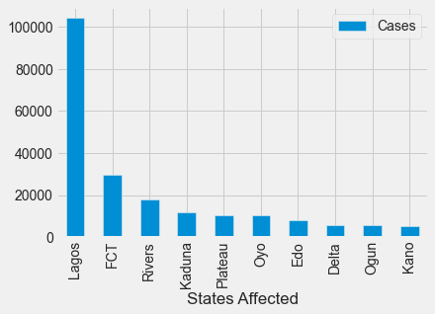
# Using DataFrame from NCDC website to plot the top ten rows based on the values in the column 'Cases'
top_ten = dff.nlargest(10, 'Cases')
# Create a bar plot
top_ten.plot(kind='bar', x='States Affected', y='Cases')
# Show the plot
plt.show()

Slide 8
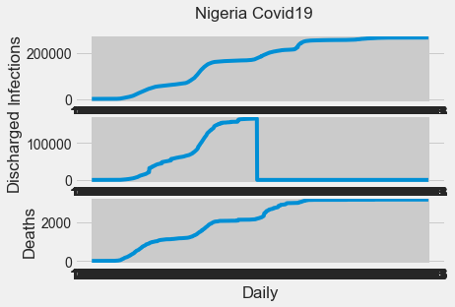
Analysis
Analysing the data with subplots.
fig, axs = plt.subplots(3)
fig.suptitle('Nigeria Covid19')
axs[0].plot(dfjn.columns, dfjn.loc['Infections'])
axs[0].set(ylabel='Infections')
axs[1].plot(dfjn.columns, dfjn.loc['Discharged'])
axs[1].set(ylabel='Discharged')
axs[2].plot(dfjn.columns, dfjn.loc['Deaths'])
axs[2].set(xlabel='Daily', ylabel='Deaths')
plt.show()

Slide 9
# Generate line plots to compare two columns in the NCDC dataset and create a figure and a set of subplots
fig, ax1 = plt.subplots()
# Plot 'Overall CCVI Index' on the first y-axis
color = 'tab:green'
ax1.set_ylabel('Overall CCVI Index', color=color)
ax1.plot(dfjc1.index, dfjc1['Overall CCVI Index'], color=color)
ax1.tick_params(axis='y', labelcolor=color)
# Create a second y-axis for 'Cases'
ax2 = ax1.twinx()
color = 'tab:purple'
ax2.set_ylabel('Cases', color=color)
ax2.plot(dfjc1.index, dfjc1['Cases'], color=color)
ax2.tick_params(axis='y', labelcolor=color)
# Show the plot
plt.show()

Slide 10
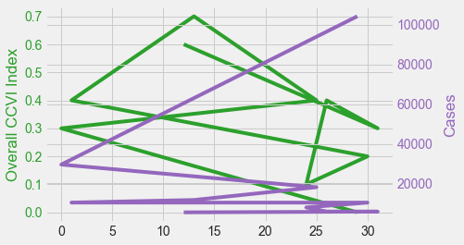
Observations
The vulnerabilty index did not influence the covid-19 cases recorded in the states as shown in the line graph comparing data for both. Lagos with the least CCVI of 0.0 had more cases than all the states in the top ten, including Kaduna with the highest CCVI of 0.7.

Slide 11
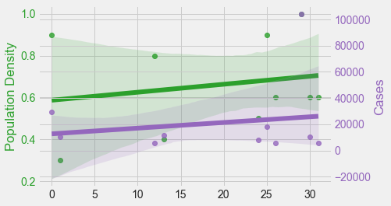
However, when the populations are compared, the case numbers appear to be more on the states with higher populations except for Kano state.

Slide 12
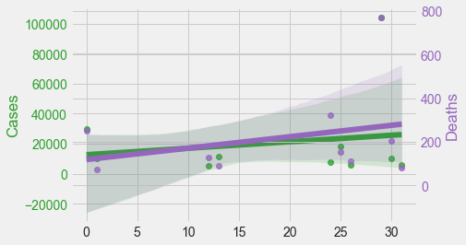
Edo state recorded 7,928 confirmed cases, zero hospitalizations, but with a mortality rate of almost 5%. This is the highest mortlity rate, making Edo State an outlier.

Slide 13
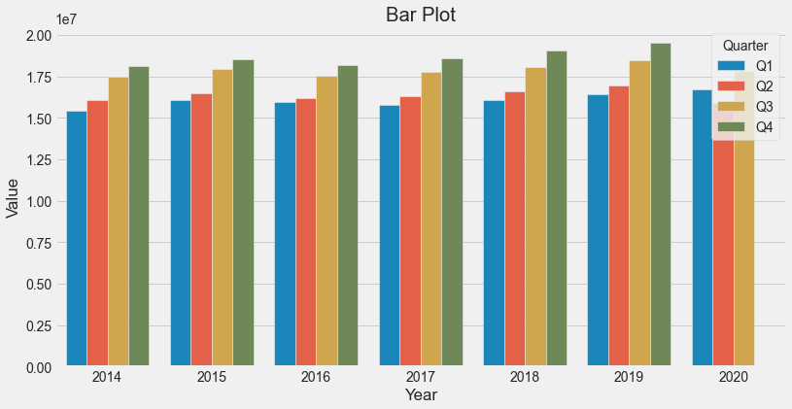
Economic Affects
The following were observed. From 2014, the GDP grew from the first quarter and climaxed by the fourth quarter of every year.

Slide 14
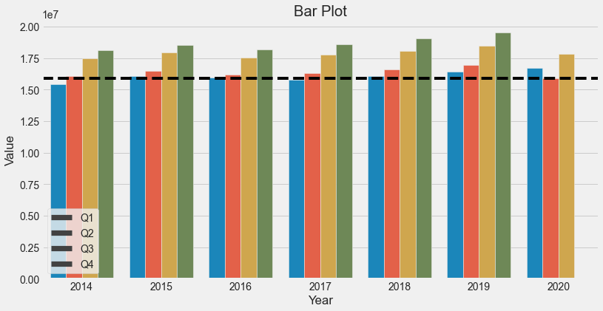
The effect of the pandemic is most noticeable when data from the first quarters are compared. 2020 outperformed the first quarters of the previous years. At the second quarter, which was at the very peak of the pandemic with shutdowns and zero economic activities, the GDP reflected this by going down.

Slide 15
Conclusions
From the studied data it can be deduced that the pandemic had a negative effect on the economy. However, the economy was resilient enough to rebound as soon as the pandemic waned. This recovery speed can only be attributed to an economy that is very robust.
Again, population densities and CCVI did not affect the overall trend of the pandemic spread. It is worthy of note that the Lagos State health system worked wonderfully well in the treatment and discharge of confirmed cases, thereby averting a high death toll.

